Slide 1
League of Legends
An API Analysis
-Ethan Soohoo

Slide 2
DISCLAIMER
I don’t play league.

Slide 3
Research Questions
What objectives of a game best indicate a win in League of Legends?
Which objectives are prioritized higher than others?
Are playerbase complaints of each other valid?

Slide 4

Intro
Notes:
MOBA = massive online battle[ground] arena

Slide 5
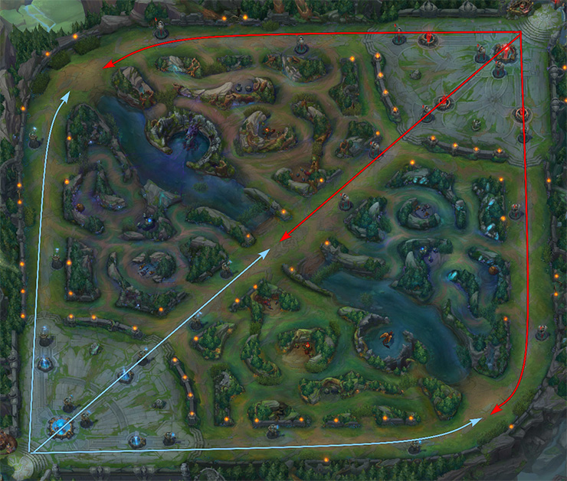

Slide 6
Basic Terms
First Blood – first kill of the game
Tower – a guardian structure that shoots at enemy heroes and minions
Inhibitor – kill to power up minions temporarily
Dragon, baron – kill for team buffs
Rift herald – kill for killing towers easier early/mid game, spawns before baron
Wards – small items to place on the map for vision

Slide 7
Game Stages
Early game – players kill mostly minions to grind for gold and xp
Mid game – begins around the first tower kill, killing structures and dragons become the new priority, teamfights begin to happen
Late game – around when one team has 3+ tower kills, inhibitor and leftover towers become highest priority

Slide 8
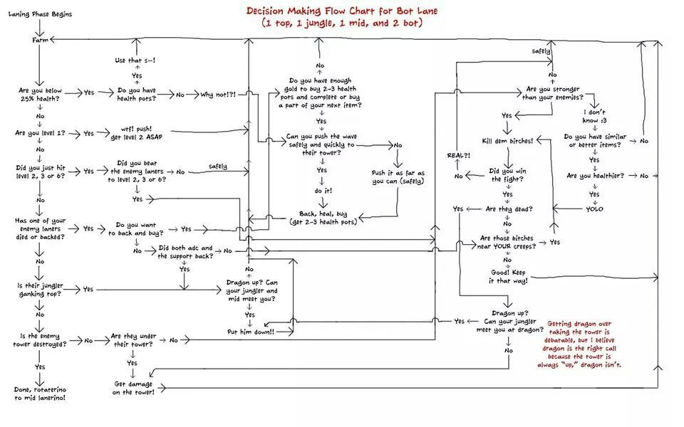

Slide 9
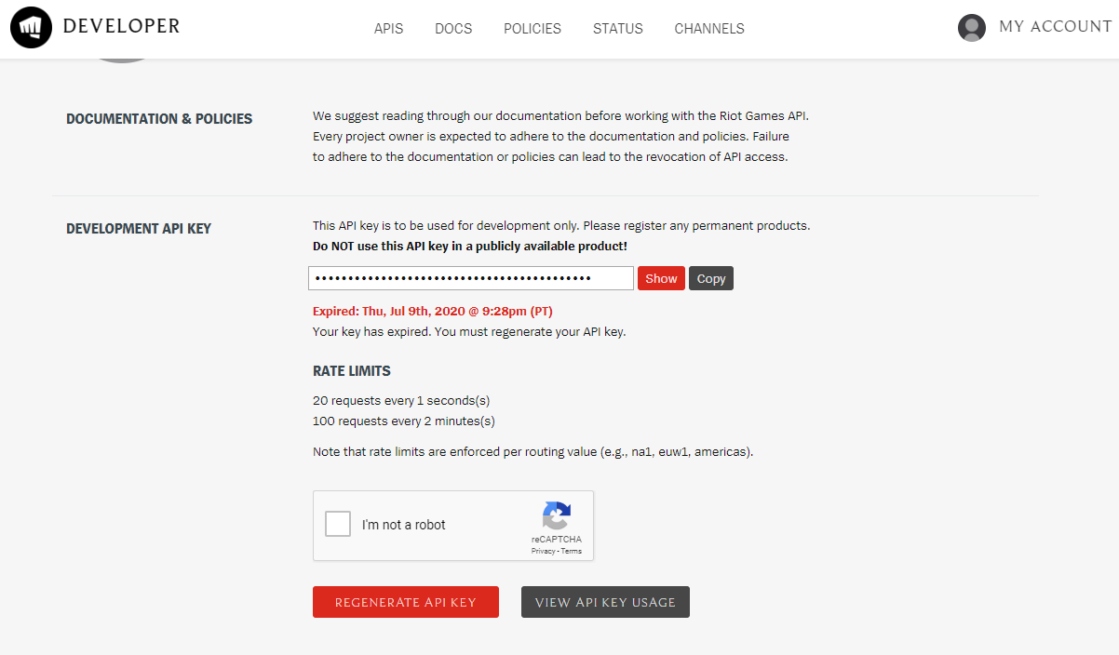
/lol/match/v4/matches/{matchId}

Slide 10
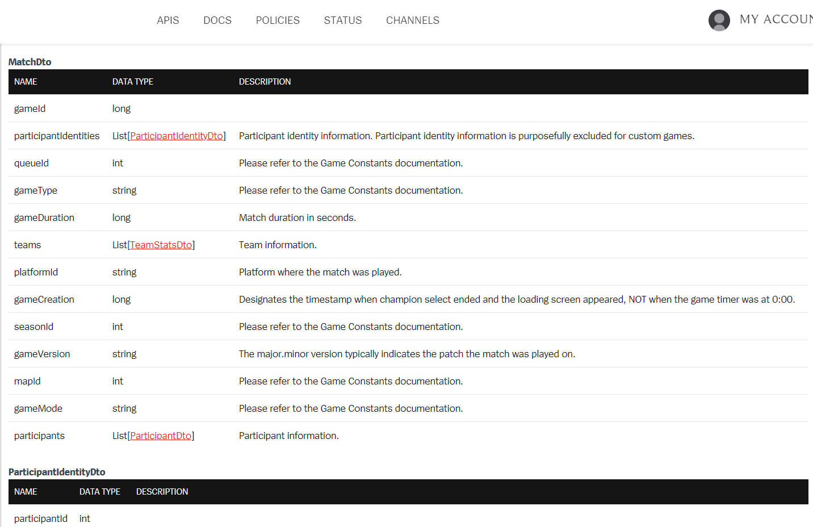

Slide 11
Data Types
Boolean | First Blood | First Tower | First Inhibitor | First Baron | First Dragon | First Rift Herald
Integer | Tower Kills | Inhibitor Kills | Baron Kills | Dragon Kills | Rift Herald Kills | Hero Kills | Hero Deaths | Wards Placed | Wards Killed
ranges | 0-11 | technically infinite, data the most is 9 | 0-4 | 0-7 | 0-2 | 0-85 | 0-85 | 0-160 | 0-87
Long | Game Duration | Gold Earned | Avg Champ Lvl | Minions Killed

Slide 12
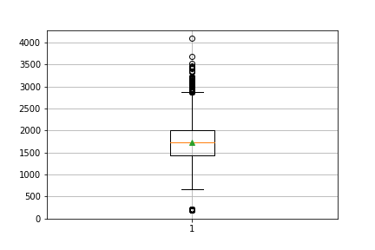
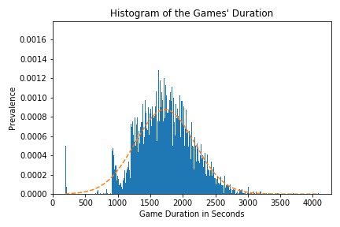
Game Durations

Slide 13
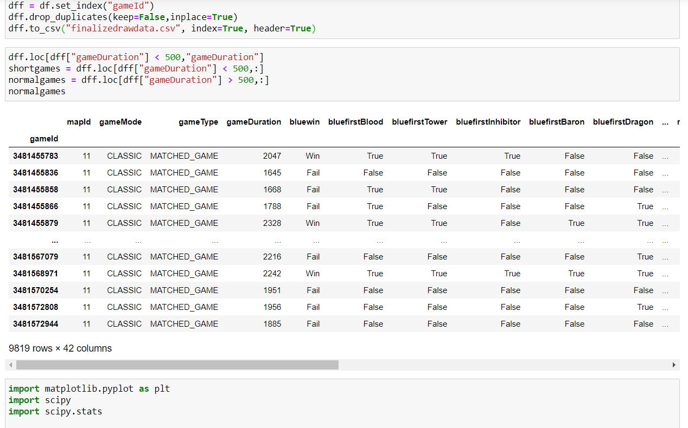

Slide 14
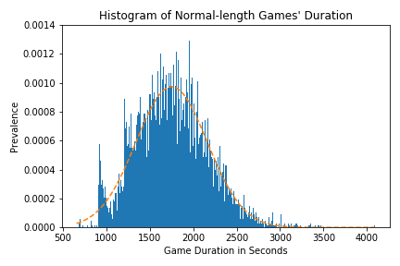

Slide 15
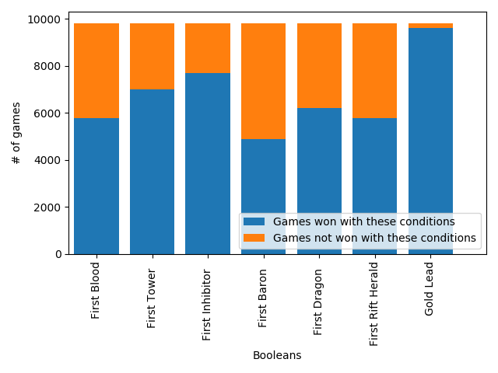

Slide 16
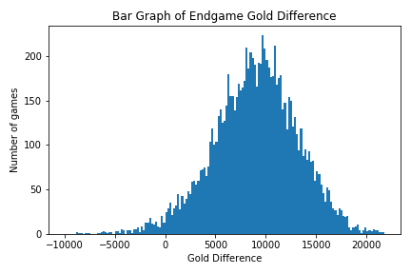

Slide 17
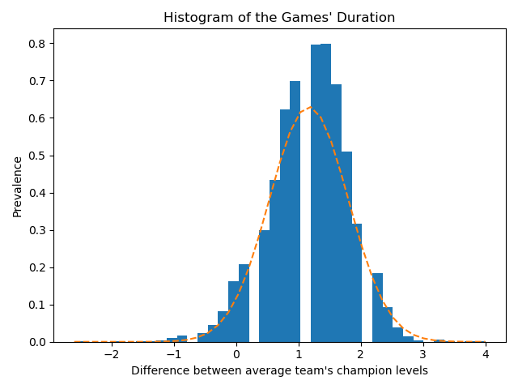
Histogram of Average Champion Levels between Winning and Losing Teams

Slide 18
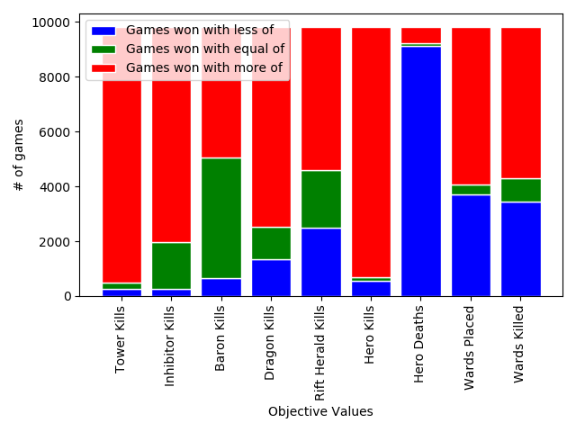

Slide 19
Conclusion
Having a gold lead is by far the best indicator of winning a League of Legends match, seconded by having a lead in player levels.
Of the “first” Boolean values, first inhibitor tends most to winning the game, followed by first tower, dragon, first blood, rift herald, and lastly baron.
Overall, having more hero kills and tower kills wins the game, having less inhibitor kills and tower kills than the other team strongly indicates losing a game, baron kills affect the game the least.
Hence the playerbase “salt” has some basis.

Slide 20
Questions?

